Slide 1



Introductions to Partner Network
CodeClan Careers Service
www.codeclan.com

Slide 2

CodeClan’s Partner Programme_
What is it
Benefits to you Job Roles
What you can do to make the most of it What our Partners want from you

Slide 3
CodeClan’s Partner Programme_
What is it?
CodeClan has an active Partner Community that provides a wide variety of networking and employment opportunities for students completing our full-time courses.
300+ partners work with us across Scotland
Ranging from early-stage start-ups to public sectors and everything in between
Companies that have hired graduates into a broad range of roles

Slide 4

CodeClan’s Partner Programme- What is it?
CodeClan, a not-for-profit organisation, was set up with the mission to bridge the digital skills gap for job-seekers and businesses alike.
CodeClan partners believe that they should be contributing to the success of the tech ecosystem.
Our Partners understand the value the CodeClan graduates have and want to invest in the future of Scotland’s tech talent.
CodeClan has an active Partner Community that provides a wide variety of networking and employment opportunities for students completing our full-time courses.
300+ partners work with us across Scotland
Ranging from early-stage start-ups to public sectors and everything in between
Companies that have hired graduates into a broad range of roles
Course fee total
Student course fee
Partner

Slide 5

Benefits to you
Often a quicker tailored hiring/interview process.
Partners are aware of your ongoing learning and development.
They understand what you are capable of at the end of the course.
They will often tailor their recruitment process to suit our graduates and have created specific onboarding and induction processes to ensure a smooth start to your career with them.
Competitive Salary
Notes:
Add information on negotiation on this slide

Slide 6
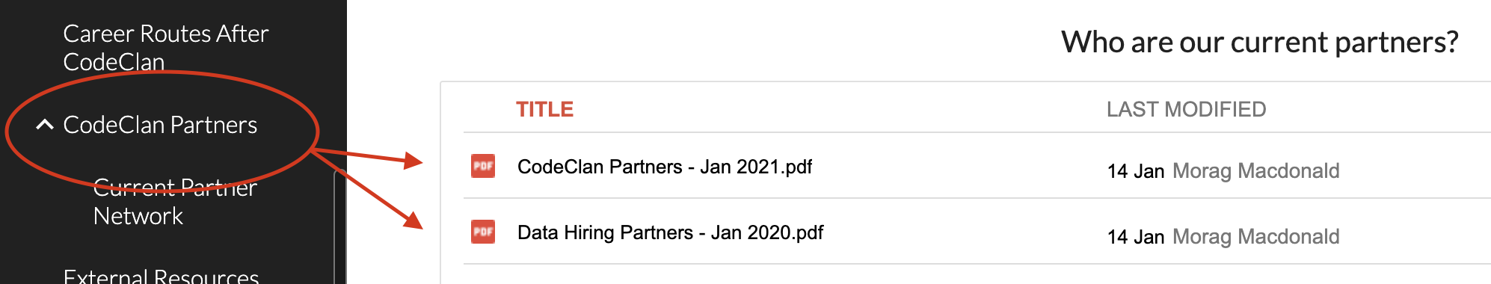
Where can I find who is a partner?
To find a current list of CodeClan partners, please go to the intranet and select CodeClan partners from the menu on the left hand side and download the most recent PDF

Slide 7







300+ Industry Partners
Notes:
These are some of our industry partners who work with us to ensure we’re delivering industry relevant skills and to support their training needs and sourcing new talent.
One of the real selling points of CC is that we are quick to respond to industry, unlike traditional institutions such as colleges or universities. Each course may be a slightly different iteration to keep your skills to relevant to the demands of industry.
Another unique strand to the relationships we have with our partnerships is in the price of the course. The full fee is made up of what our students pay topped up by a fee that our partners pay when they hire you. This enables us to keep costs lower for you and demonstrates the good faith our partners have in investing in the skills of CodeClan graduates.
The quality and commitment of CodeClan graduates means that a growing number of partners come back to hire again and again, we’re going to hear from some of them now.

Slide 8
Tech is a fast paced industry that is constantly evolving. That includes languages and software used.
It might mean that you can get overwhelmed with the amount of options available to you, even as a Junior.

Slide 9
Some Data Stats_
“The ability to read, understand and create data is the most sought after skill in modern businesses”
(Regional Head of Waterstons, 2019)
Demand for data skills has tripled in 5 years (+231%)
(Royal Society Report, 2019)
718 jobs in Scotland contain the keyword ‘data’
(S1 Jobs, Nov 2019)
“Data Driven Innovation could deliver £20bn in productivity next 5 years”
(Digit, 2019)
“Demand has grown sixfold compared to five years ago, and data analysts will continue to be the most sought after profiles over the next 5 years” - LinkedIn
“Data represents a £20 billion opportunity to Scotland over the next five years”
(Scottish Enterprise, 2019)
Notes:
Notes:
These are just a few quotes that caught my eye recently.
Justification:
The rapid growth for data has also led to a concomitant growth in demand for professionals skilled in data analytics. Five SMEs out of 10 declare they will hire one in next 10 years
https://www.morningfuture.com/en/article/2018/02/21/data-analyst-data-scientist-big-data-work/235/
World Economic Forum forecasts that by 2020 data analysts will be in high demand in companies around the world.
The LinkedIn Workforce Report maintains that, in the USA, demand for these professional figures has grown sixfold compared to five years ago, and data analysts will continue to be the most sought after profiles over the next five years.
This is further confirmed by IBM, which claims that the annual demand for data scientists, data developers and data engineers will lead to 700,000 new recruitments by 2020.
Companies, both big and small, are competing in the employment market in order to bring skilled data professionals on board, while many organisations have even commenced in-house training of data professionals from within their own talent pools to address their data analytics requirements. https://www.entrepreneur.com/article/279333
Quote from Ricky Milliken, Regional Head, Waterstons re Digital Transformation in business:
“Data literacy, the ability to read, understand, create, and communicate data as information, is one of the most sought after skills in modern businesses, and one of the things that separates a truly excellent digital transformation strategy from a merely ‘fine’ one is the focus on using the momentum to upskill staff so they are best equipped to operate in their new digital world.”
https://digit.fyi/digital-literacy-digital-transformation-comment/
Demand for Business/Management Analyst roles in the USA is predicted to grow by 14.3% over the next 10 years, attracting a median annual salary of $81k. (Source: Bureau of Labor Statistics (projected growth) and Burning Glass analysis.
Skills such as Python and machine learning are in very high demand in virtually every business sector
A deep understanding of predictive analysis has become pivotal to business success
Data scientist is the “hottest job function” now for employers, says Andrew Lo, director of the MIT Laboratory for Financial Engineering in Cambridge, Mass.
Lo says data portfolio managers, who are charged with maintaining and maximizing the value of a company’s data assets, also are gaining importance.
“Certainly in the financial sector people are already pretty highly trained, so I do believe they can be retrained to focus on data science and all of the job functions that are required to support data science analytics,” says MIT’s Lo. “That’s not true in all industries.”
Salary levels: The median annual salary for a Data Analyst was £40,000 in advertised job vacancies across the UK during the 6 months to 5 November 2019.

Slide 10

Before you begin looking_
In the field of “data” identifying the jobs you want to look for can get complicated quickly for a couple of reasons:
There is no universal definition of “data analyst” or “data scientist” that every company agrees on. Different positions with the same title may require different skill sets, or they may require exactly the same skills
There are MANY other job titles that involve data that you might not find if you’re just searching for “data analyst” or “data scientist”. Don’t limit yourself.
Notes:
The first step in any job search is identifying the types of jobs you should be looking for. In the field of data science, this gets complicated quickly, for a couple of reasons:
There’s no universal definition of “data scientist” or “data analyst” that every company agrees on, so different positions with the same title may require different skill sets
There are a plethora of other commonly-used job titles that involve data science work that you might not find if you’re just searching for “data analyst” or “data scientist” roles.

Slide 11
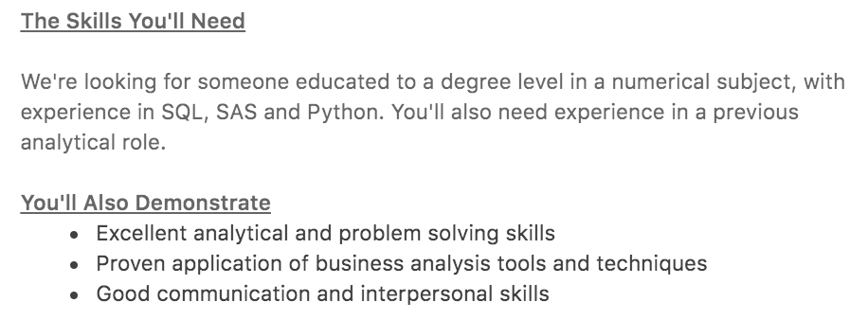
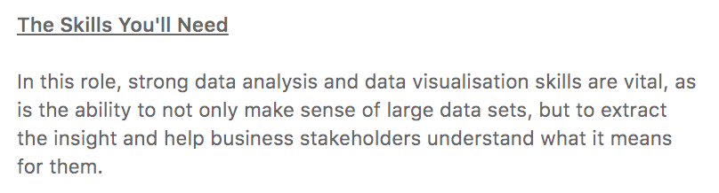
Focus on the skills, not the title_

Slide 12
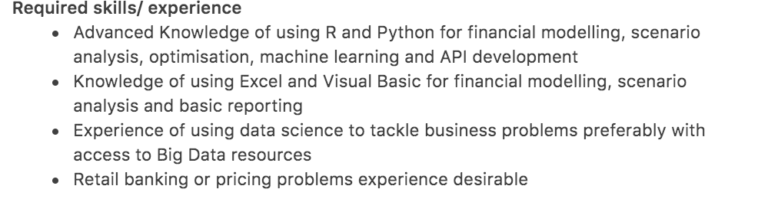
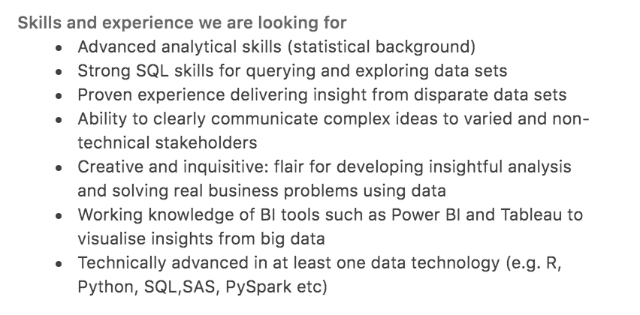
Focus on the skills, not the title_

Slide 13

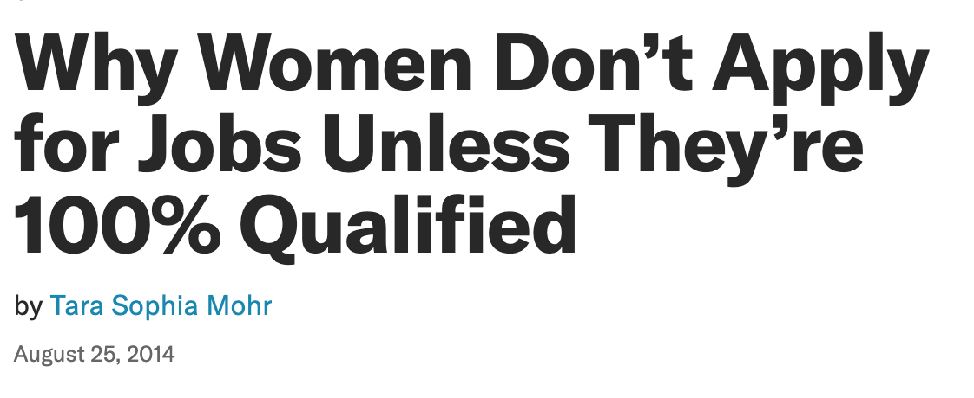
Apply_
Apply even if you don’t meet 100% of the criteria. Job adverts represent the perfect candidate, but organisations rarely find perfection.
https://hbr.org/2014/08/why-women-dont-apply-for-jobs-unless-theyre-100-qualified

Slide 14
Core Data Team_
A core data team typically consists of these three roles (although some of the role titles will be used interchangeably)
Data engineer: responsible for moving and propagating access to data. Chief mandate is to get data in the right place
Data analyst: focused on answering business questions using data. This person effectively serves as the bridge between data and business insights.
Data scientist: main job is to build predictive models and automated classifications off existing data
Data
Engineer
Data
Analyst
Data
Scientist

Slide 15
PSD Job roles
Your CodeClan course will qualify you as a Junior Software Developer.
This means you can go on to do Front End or Back End Software Development. BUT
The opportunities don’t stop there…

Slide 16
Can you guess what these job roles involve?
Cloud Engineer UI Developer
BI Developer QA Tester
Full Stack Developer SOC Analyst
IOS Developer Business Systems Analyst
Android Developer Associate Product Manager
UX Designer DevOps Engineer
Notes:
Get them to work in pairs or groups or individually and find a description of what each of these roles involve. Give them 5mins and ask for volunteers to feed back to the group.

Slide 17
Can you guess what these job roles involve?
Cloud Engineer UI Developer
BI Developer QA Tester
Full Stack Developer SOC Analyst
IOS Developer Business Systems Analyst
Android Developer Associate Product Manager
UX Designer DevOps Engineer
Notes:
Our Partners have hired CC students for those roles in red over the last 6 months - it is important for you to keep up to date with the types of roles out there and what is involved.

Slide 18
Job Roles
Did you know them all? No?
Didn’t expect you to!
The Tech industry is constantly evolving and it will continue to do so it’s up to you to keep your finger on the pulse and learn what these jobs entail.
One thing to keep in mind that all our Partner roles are looking for YOU at Junior Level
Notes:
Take cloud engineering for an example...it is a growing sector and the demand for cloud engineers will gradually increase over the next few years. In order to get a role in this you may need to do additional training, what can you do to increase your knowledge and confidence when it comes to what the industry needs? Take suggestions now and move to next slide to discuss the top 3 actions they all should start to take

Slide 19
What can you do to develop your knowledge?
Research job vacancies
Continue your learning
Attend Hiring Talks/Networking Sessions
Notes:
We will go into a bit more detail with each point in the next few slides

Slide 20
Research Job Vacancies
Use the Intranet/Linkedin/job sites - not just Junior but Mid level and Senior roles. Junior roles are not always what you expect
Familiarise yourself with the skills and languages required. Highlight anything that is new or that you are not confident in and action that for you to learn and develop. Google is your friend...
Notes:
Create goals for yourself by jotting down technical skills or knowledge that is listed on job vacancies. You can work on building your knowledge and skills now or keep a note and use this as your next steps once you complete the course. Don’t just focus on junior roles but be aspirational. Think about where you want to be in the future. Dress for the job you want…or so the saying goes!

Slide 21
Continue your Learning
Alison.com
Codeacademy
Coursera
Dash General Assembly
EdX
Harvard Online Learning
Khan Academy
MicrosoftLearn
MIT OpenCourseWare
Skillshare
Udacity
Udemy
Notes:
These sites are handy to have, you can do free (or at least very cheap) courses to upskill and develop knowledge on emerging technologies. Don’t know where to start? Check out the popular/most in demand section as a starting point, they are in demand for a reason. Some will give you certifications that you can highlight on CVs/in covering letters/add to linkedin or talk about at interviews. Remember that Linkedin also has learning that you can ultise. These are GOLD on CVs and employers frequently comment on this as an impressive addition. It also helps to set yourself apart from everyone else in the cohort.
https://www.cio.com/article/3281388/8-free-online-course-sites-for-growing-your-tech-skills.html

Slide 22
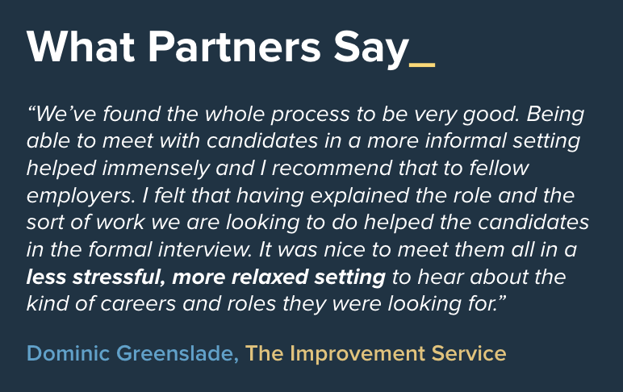
Attend Hiring Talks/Networking Sessions
Partners often come and present to our students on their company and live job opportunities:
which can result in...
Further networking
Pre-interview mini networking sessions
Interviews
Opportunities to connect
ADVERTISED ON ALL STUDENTS SLACK CHANNEL
Notes:
Always take a pen/paper or have a document open on the computer to take notes. At the very least jot down the full names of the speakers so you can connect with them on linkedin or possibly email them with questions. You never know who will come in handy in the future!

Slide 23
What do our Partners Admire in YOU?
Communication
Organisation
Analytical Abilities
Creativity
Project Management
Perseverance
Problem Solving
Resourcefulness
Curiosity
Willingness to help others
And most importantly….. PASSION AND ENTHUSIASM
Notes:
Lastly, remember that building your knowledge and technical skills is only part of what you should be doing. This will naturally happen when you are in a role. The employers want codeclan graduates because the breadth of skills and experience you bring that you developed in other roles. Don’t underestimate the importance of these ‘soft skills’. Technical skills can be learned more easily than soft skills. Here are the main skills that are valued highly in the tech sector so own them and showcase them because that is what will get you the job!
Reference: https://www.comptia.org/career-change/exploring-it/skills-for-it

Slide 24
Any Questions…

